Slide 1
A Few of my favorite things
Presented by Kristi Bruce, 4th Grade Teacher, Auburn Elementary

Slide 2
The Plan
Organization
Math
Reading/Writing
Science/Social Studies
Holidays
Technology
Miscellaneous
KTOY Visits!
Please question and share as we go!

Slide 3
Organization

Slide 4
Organization
Mini Checklists

Slide 5
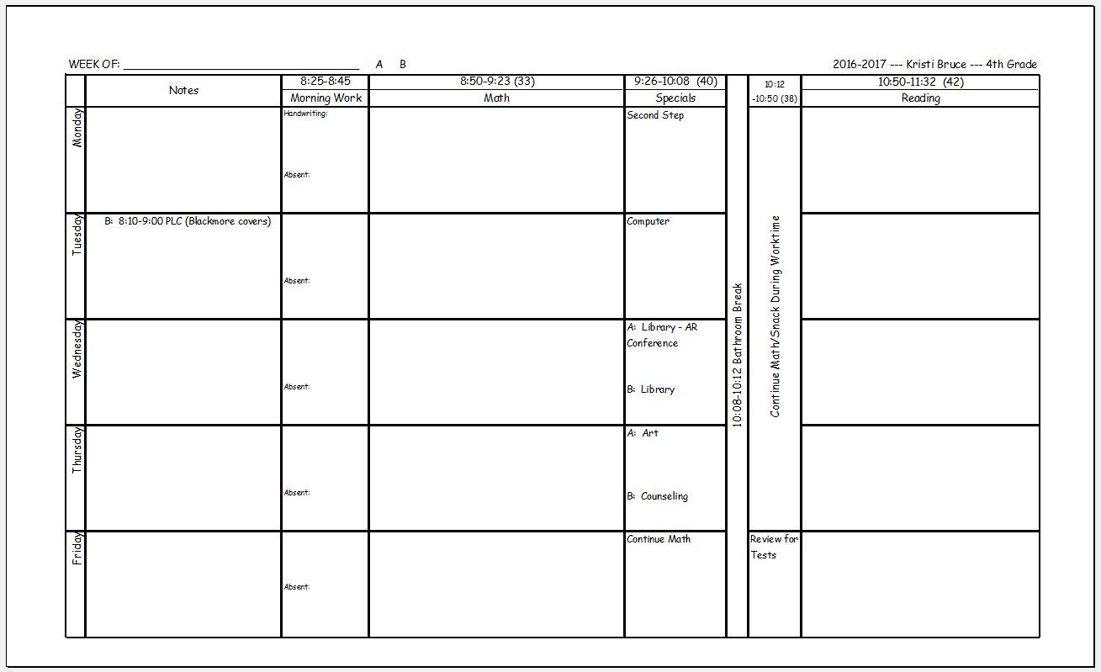
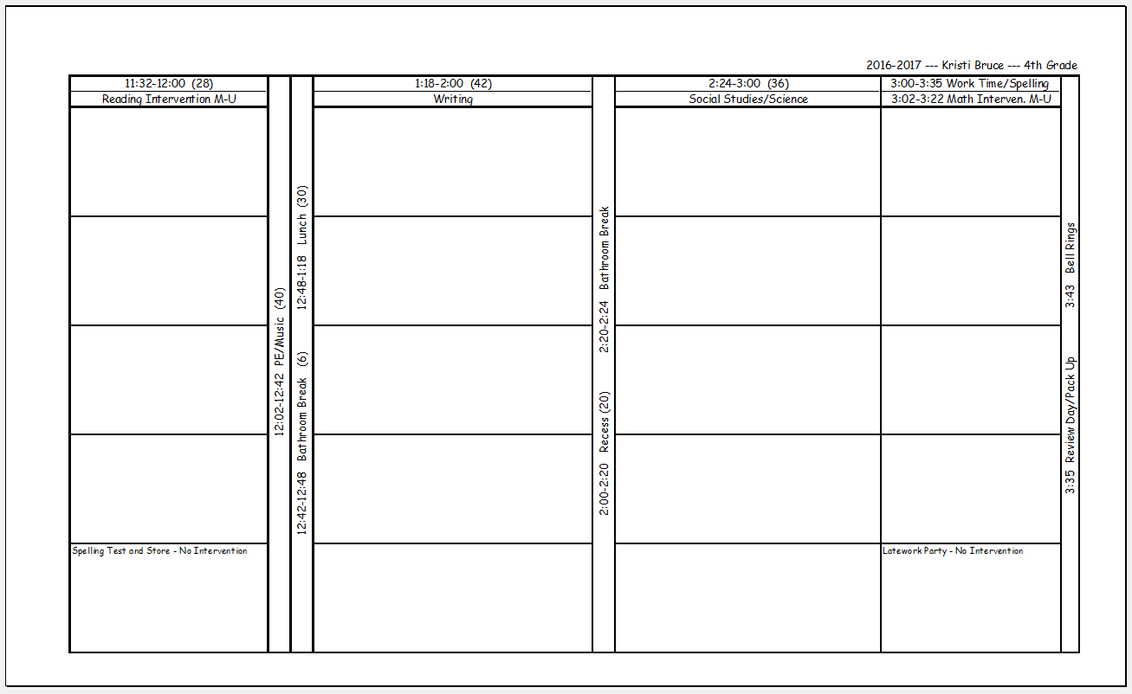
Organization
Mini Checklists
Lesson Plan Book in Excel

Slide 6
Organization
Mini Checklists
Lesson Plan Book in Excel
Pacing Guide in Excel

Slide 7
Organization
Mini Checklists
Lesson Plan Book in Excel
Pacing Guide in Excel
Task Card Holders (Lakeside.com, 1600 Photo Organizer Case $19.95)

Slide 8
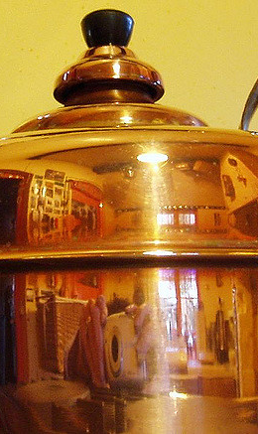
Math

Slide 9
Math
Regroup = Borrow, Break It, Combine It

Slide 10
Math
Regroup = Borrow, Break It, Combine It
Groups Of!

Slide 11
Math
Regroup = Borrow, Break It, Combine It
Groups Of!
Multiplication Strips
Created by 3rd Grade Gridiron Graphics by KPM Doodles and Revi Devi

Slide 12
Math
Regroup = Borrow, Break It, Combine It
Groups Of!
Multiplication Strips
Scoot, Cross, Scribble

Slide 13
Math
Factors of 7 are 1,7
It is “primey”
(2 factors = 2 syllables)
Factors of 8 are 1, 2, 4, 8
It is “composite”
(3 or more factors = 3 syllables)
Regroup = Borrow, Break It, Combine It
Groups Of!
Multiplication Strips
Scoot, Cross, Scribble
Primey/Composite

Slide 14
Math
Regroup = Borrow, Break It, Combine It
Groups Of!
Multiplication Strips
Scoot, Cross, Scribble
Primey/Composite
Factor Ninja = Chop It Up!
http://youngteacherlove.com/factors-and-multiples/

Slide 15
Math
Regroup = Borrow, Break It, Combine It
Groups Of!
Multiplication Strips
Scoot, Cross, Scribble
Primey/Composite
Factor Ninja = Chop It Up!
Multiple Monster = Makes It Bigger and Bigger and Bigger!
Factor vs. Multiple Lists

Slide 16
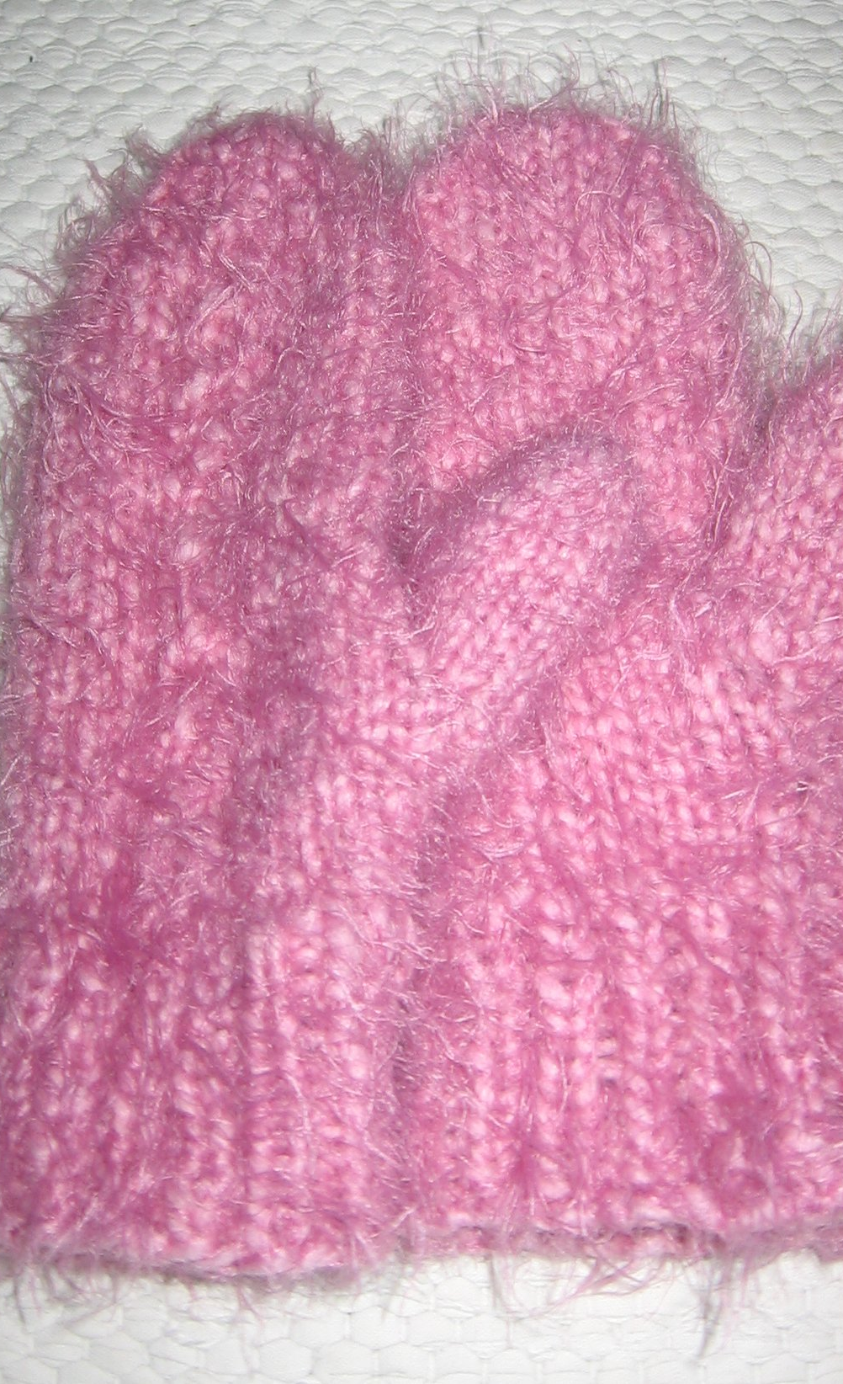
Reading/Writing

Slide 17
Reading/Writing
Favorite Read Aloud Books
Because of Winn-Dixie
Enormous Egg
Frindle
Jayhawker

Slide 18
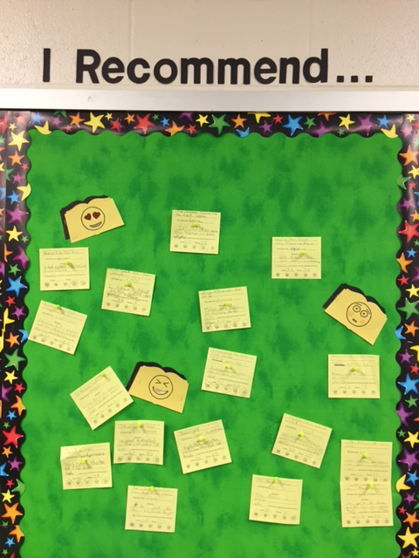
Reading/Writing
Favorite Read Aloud Books
I Recommend. . .

Slide 19
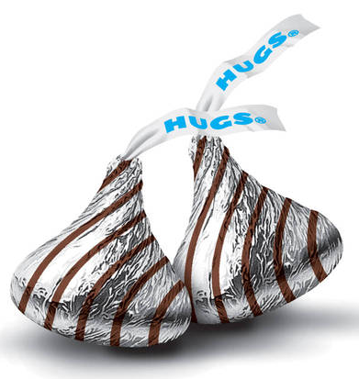
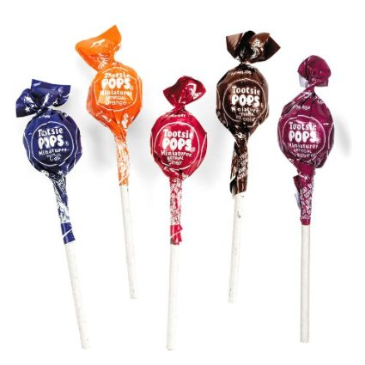
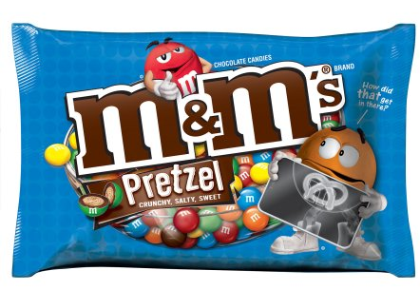
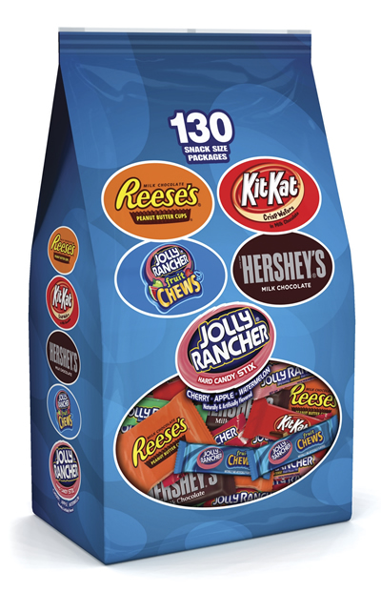
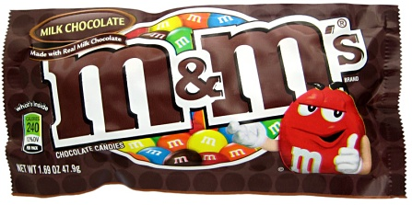
Reading/Writing
Favorite Read Aloud Books
I Recommend. . .
Text Structure Candy Project
Description
Sequence
Cause/Effect
Compare/Contrast
Problem/Solution

Slide 20
Reading/Writing
Favorite Read Aloud Books
Text Structure Candy Project
Vocabulary Structure

Slide 21
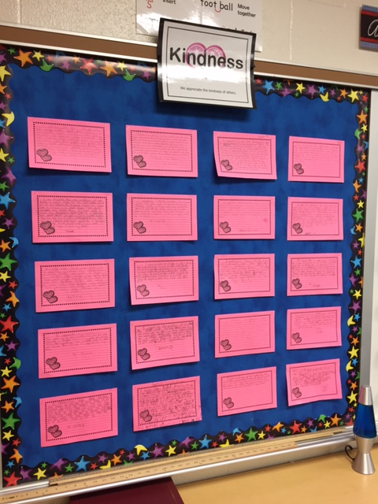
Reading/Writing
Favorite Read Aloud Books
I Recommend. . .
Text Structure Candy Project
Vocabulary Structure
Monthly Paragraphs

Slide 22
Reading/Writing
Favorite Read Aloud Books
I Recommend. . .
Text Structure Candy Project
Vocabulary Structure
Monthly Paragraphs
Cursive Help

Slide 23
Science/Social Studies

Slide 24
Science/Social Studies
U.S. History Timeline on TPT

Slide 25
Science/Social Studies
U.S. History Timeline
State Projects

Slide 26
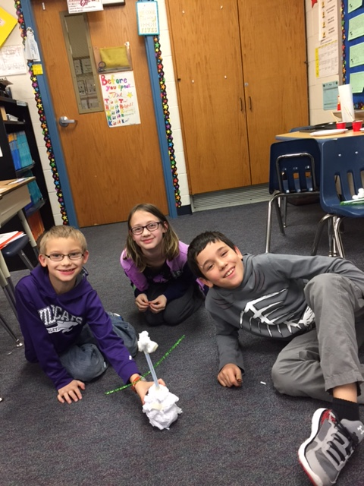
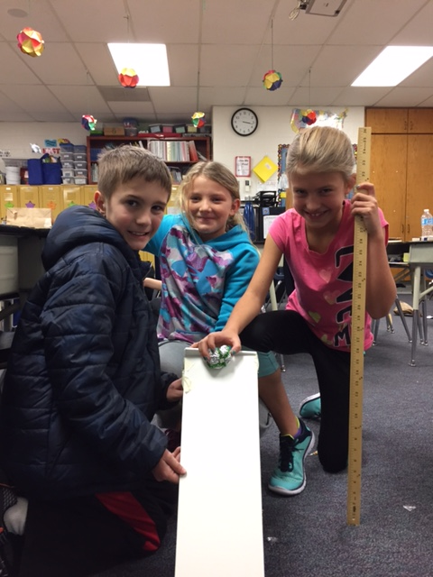
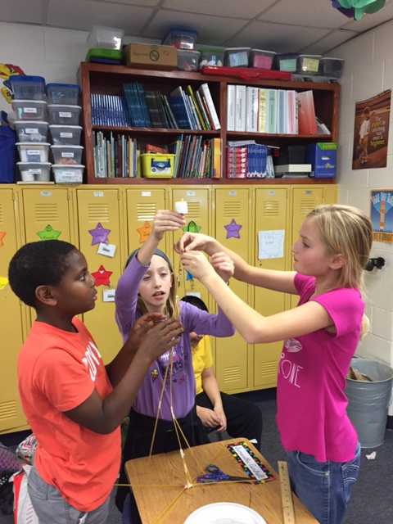
Science/Social Studies
U.S. History Timeline
State Projects
STEM Challenges

Slide 27
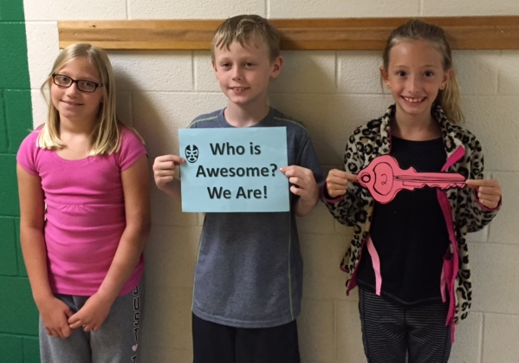
Science/Social Studies
U.S. History Timeline
State Projects
STEM Challenges
Escape the Classroom

Slide 28
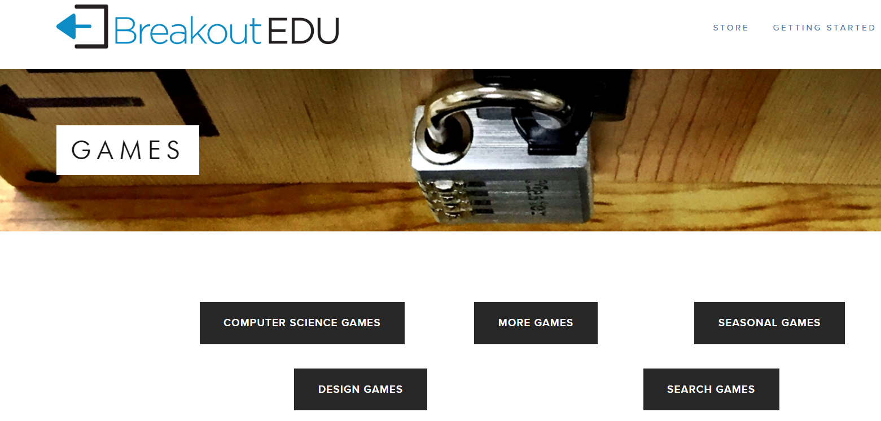
Science/Social Studies
U.S. History Timeline
State Projects
STEM Challenges
Escape the Classroom
Break Out EDU

Slide 29
Holidays

Slide 30
Holidays
Coupons

Slide 31
Holidays
Coupons
Silhouette Ornaments

Slide 32
Technology
Document Camera
Weebly.com
Educreations
Ozobot
Code.org
Google Docs, Suggested Editing

Slide 33
Miscellaneous

Slide 34
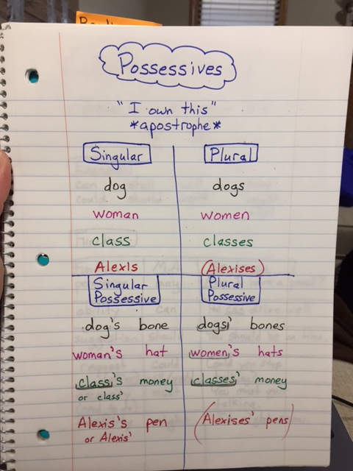
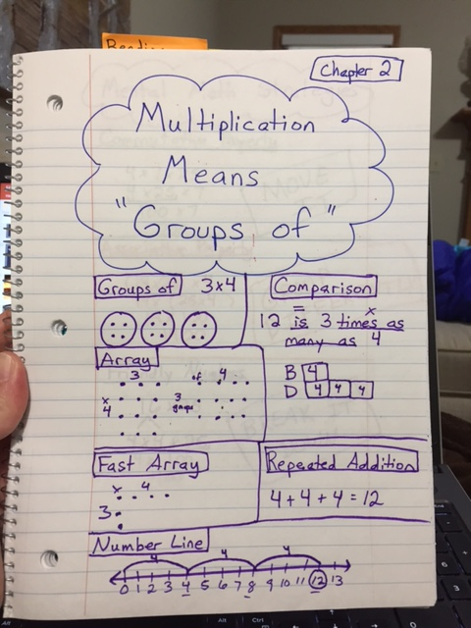
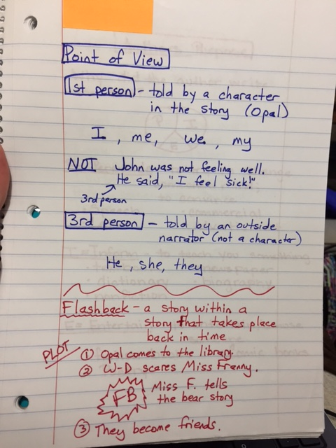
Miscellaneous
Notesbook

Slide 35
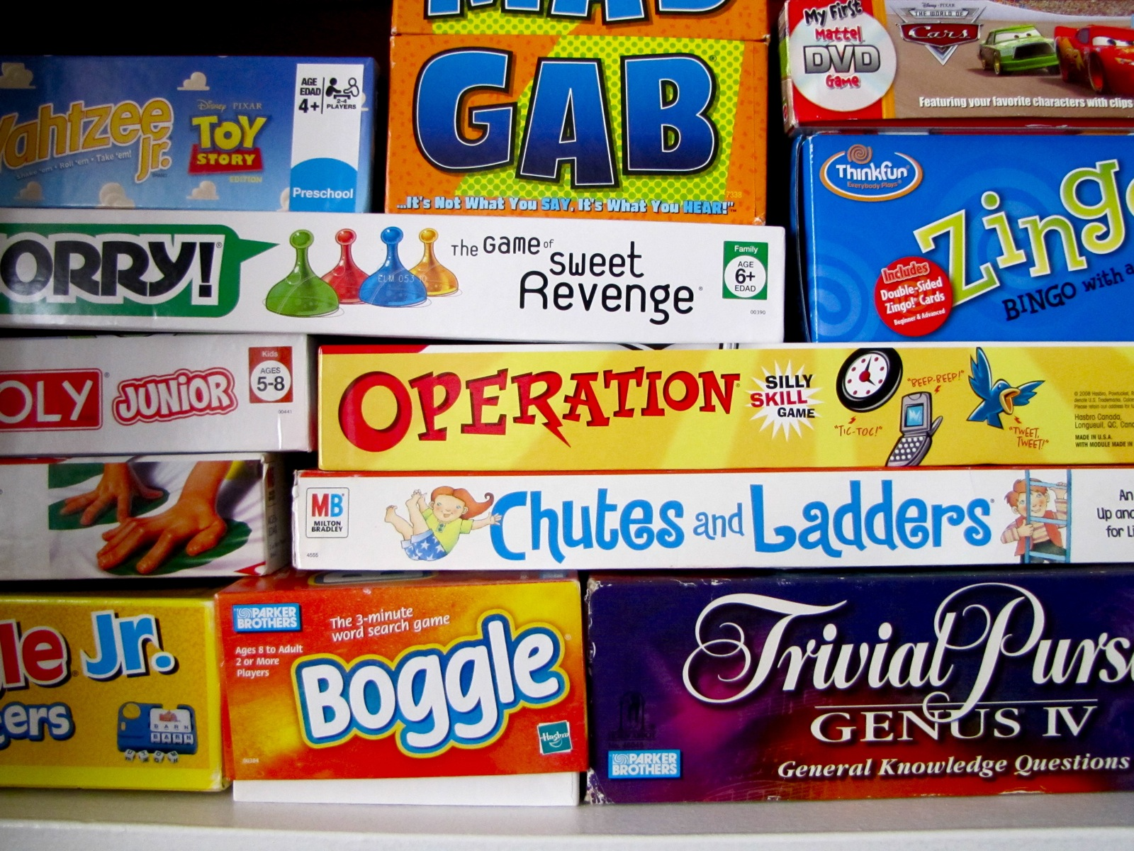
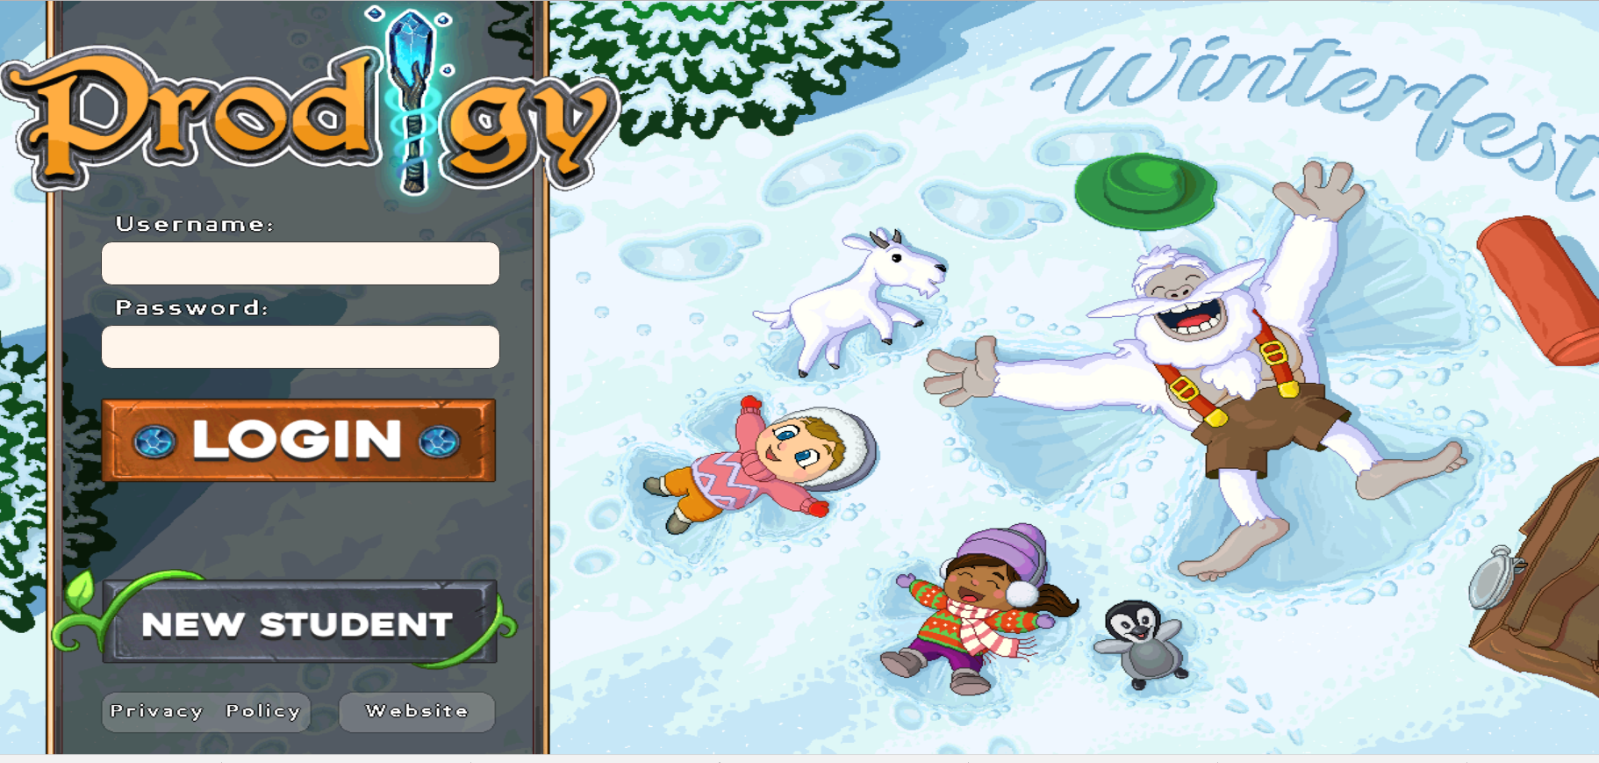
Miscellaneous
Notesbook
Latework Party

Slide 36
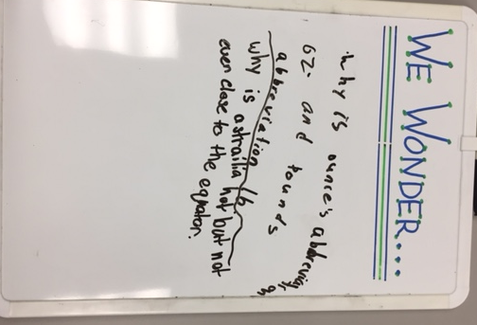
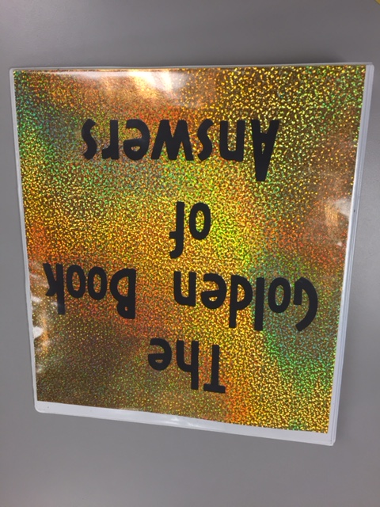
Miscellaneous
Notesbook
Latework Party
We Wonder – Golden Book of Answers

Slide 37
Miscellaneous
Notesbook
Latework Party
We Wonder – Golden Book of Answers
Flex Scoot

Slide 38
Miscellaneous
Notesbook
Latework Party
We Wonder – Golden Book of Answers
Flex Scoot
Classroom Cash and Coupons

Slide 39
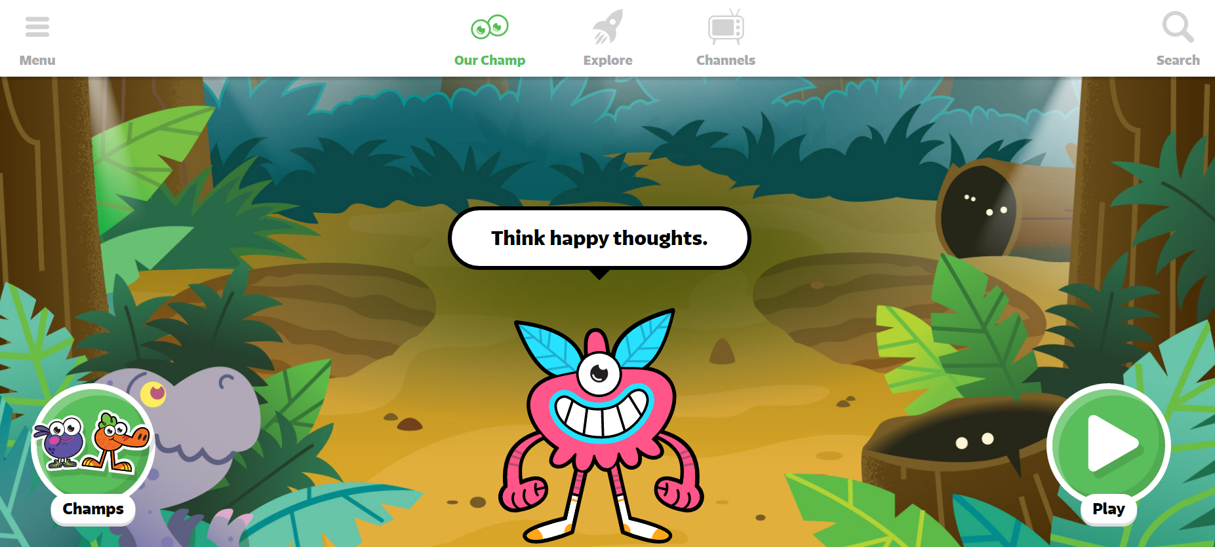
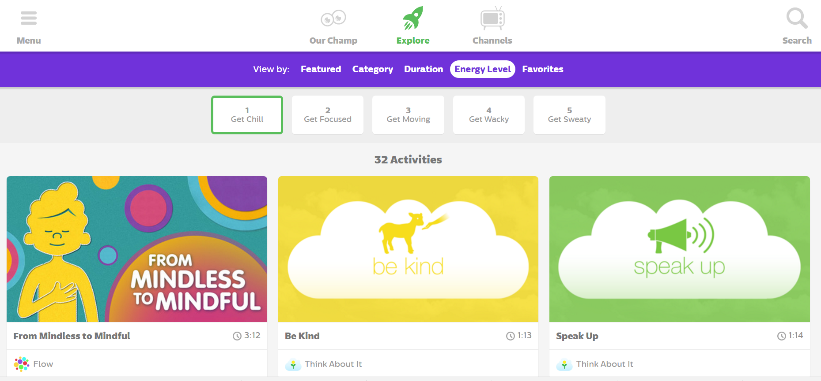
Miscellaneous
Notesbook
Latework Party
We Wonder – Golden Book of Answers
Flex Scoot
Classroom Cash and Coupons
(Go Noodle)

Slide 40
More Miscellaneous!

Slide 41
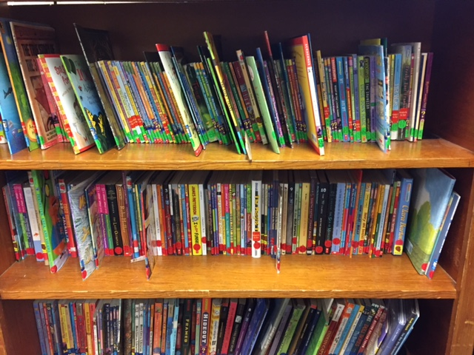
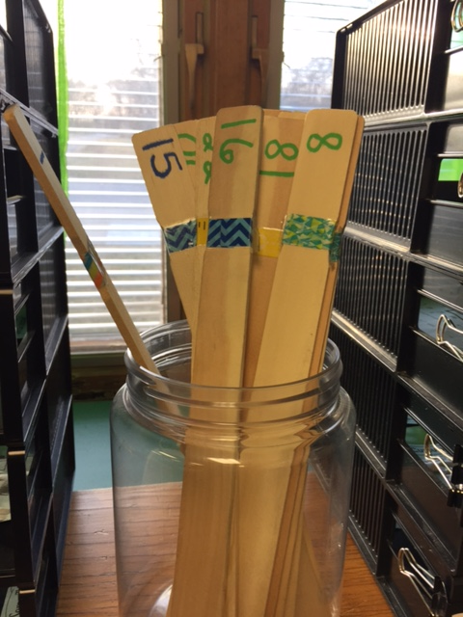
More Miscellaneous!
AR Book Labeling and Check Out System

Slide 42
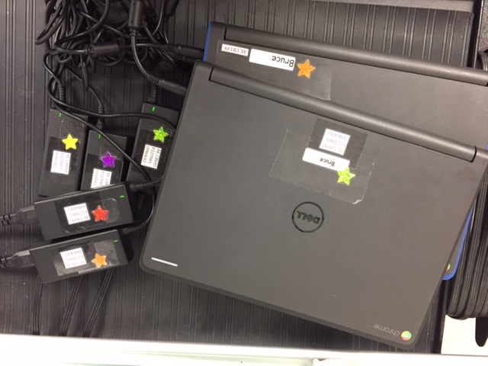
More Miscellaneous!
AR Book Labeling and Check Out System
Computer Labeling

Slide 43
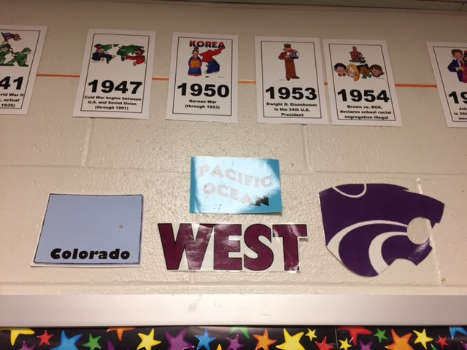
More Miscellaneous!
AR Book Labeling and Check Out System
Computer Labeling
Directional Signs

Slide 44
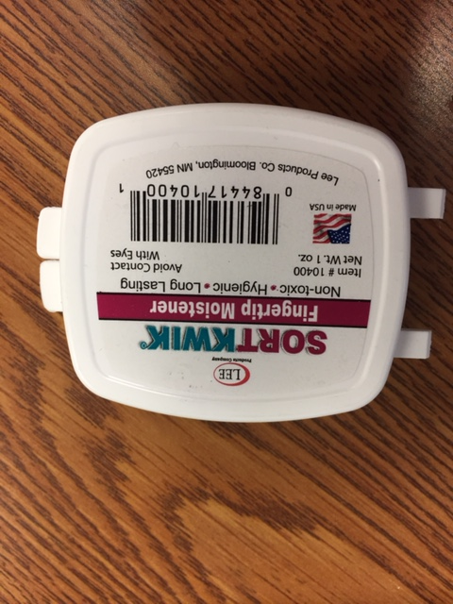
More Miscellaneous!
AR Book Labeling and Check Out System
Computer Labeling
Directional Signs
SortKwik

Slide 45
More Miscellaneous!
AR Book Labeling and Check Out System
Computer Labeling
Directional Signs
SortKwik
Staple Remover

Slide 46
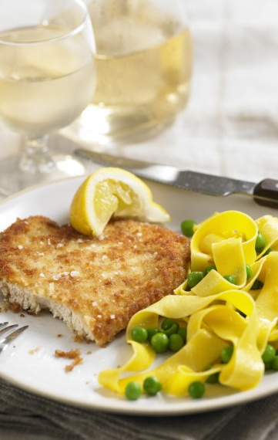
KTOY Visits
GetKahoot – Learning Games
Dibels App – for the iPad
High School Grads come back to elementary schools
Zearn Math – Based on Eureka Math, Engage NY; Embarc Online
Augmented Reality – iPads, iPhones, Chromebook Cameras
Genius Hour
#ksedchat

Slide 47
KTOY Book Recommendations

Slide 48
KTOY Inspirational Videos
Power of Why, Michael Jr.

Slide 49
KTOY Inspirational Videos
Rita Pierson, Every Kid Needs a Champion

Slide 50
Questions?

Slide 51
Contact Me!
brucekri@usd437.net @KristiBruce94 @KTOY2017 tinyurl.com/KTOY2017
aebruce.weebly.com

