Slide 1
Mindfulness and Brain Breaks
Presented by Kristi Bruce
4th Grade Teacher
Auburn Elementary
Music: Embers, Helen Jane Long, Amazon Music

Slide 5
Teacher Burnout
“. . .teacher education focuses primarily on content and pedagogy, often overlooking the social, emotional, and cognitive demands of teaching. New teachers can easily become overwhelmed by these demands and the demands of daily lesson planning, organization, assessment, and classroom management. . . Adding to these demands is the increasing number of children who come to school with unmet needs.”
Mindfulness for Teachers, p. xxiv

Slide 8
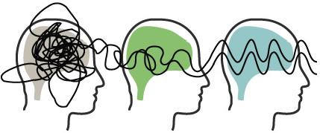
What is Mindfulness?
“You can think of it as ‘fullness of mind,’ because you bring your full, undivided attention to the present moment.”
Mindfulness for Teachers, p. 1
http://www.mindfulrevolution.co.za/

Slide 9
Let’s Practice!

Slide 10
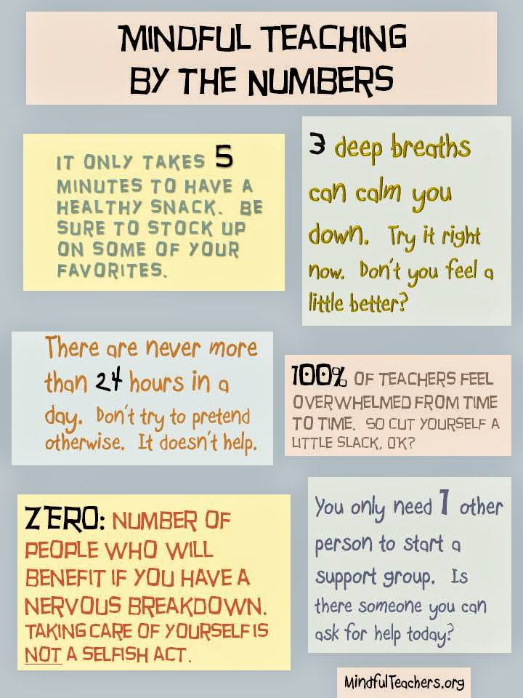

Slide 11
Setting Intention
“My intention is to enjoy my class today.”
“Today I intend to find something positive to enjoy.”
“My intention is to remain calm during transition times.”
Mindfulness for Teachers, p. 23

Slide 12
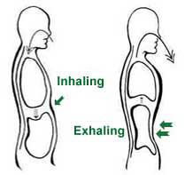
Three Breaths
Hands on your abdomen
Breathe with your diaphragm, fill body with air
From your nose to the bottom of your lungs
Feel the flow out of your body
Mindfulness for Teachers, p. 24
http://www.nosleeplessnights.com/sleep-hygiene/relaxation-techniques/

Slide 13
Emotional Regulation
“. . . when kids come from unstable, chaotic home environments, they can become hypervigilant to adult emotions that might be threatening. They are on high alert so they can protect themselves in case someone becomes violent. . . The emotional challenges that we face in the classroom often involve dealing with student who have problems with self-regulation.”
Mindfulness for Teachers, p. 59

Slide 14
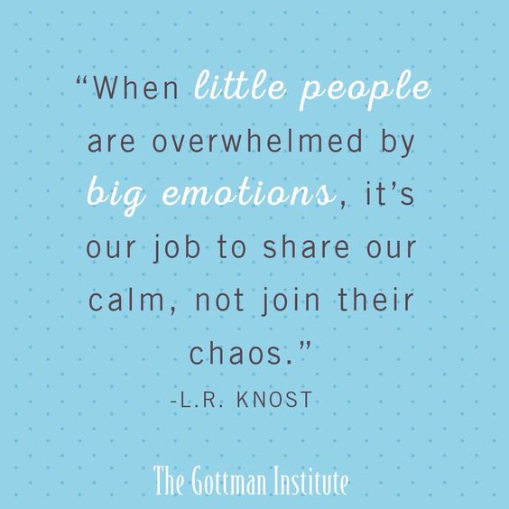

Slide 15
Positive Emotions
“. . .effect of positive emotions helps build a sense of well-being that promotes survival in the long term. Positive emotions enhance cognitive abilities and promote strong and enduring social relationships, good health, longevity, resistance to illness. . . directly contribute to improvements in our overall life satisfaction (Fredickson, 2009).”
Mindfulness for Teachers, p. 88

Slide 16
Joy
Love
Interest
Gratitude
Pride
Hope
Mindfulness for Teachers, p. 93-102

Slide 17
Benefits of Mindfulness During Conflict
Calm myself down
Avoid confrontation that might damage a student relationship, creating tension in the classroom, possibly derailing other students’ learning
Strengthen relationship with student by responding to a need
Mindfulness for Teachers, p. 5

Slide 18
Care and Limits
“The teacher-student relationship is not a friendship. It is a professional caring relationship that is part of our job.”
Mindfulness for Teachers, p. 126

Slide 19
Classroom Dynamics
Emotional Climate
Reducing Noise
Arranging Students and Furniture
Transitions
Mindful Communication
Community of Learners
Good Relationships
Rules and Procedures
Conflict Resolution
Mindful Wait Time
Responding to Challenging Behavior
Dynamic Instruction (Lesson Movement)
Mindfulness for Teachers, Chapter 6

Slide 20
Calm.com
The Calm Classroom Initiative – free access to Calm Tools
Do Nothing for 2 Minutes

Slide 21
Great Links
Mindfulness Exercises for Children from Therapistaid.com
When Mindfulness Feels Like a Necessity from Edutopia
Teacher Well-Being from Huffington Post
Mindful Schools Online Courses
Teachers Need to Breathe from NPR
Secondary Brain Breaks from Colorado Education Initiative

Slide 22
Brain Breaks and Learning Games
Because Movement Matters!

Slide 23
What is GoNoodle?
GoNoodle is a free website that helps kids channel their physical and emotional energy for good.
It has short desk-side physical activities help teachers manage their classroom and improve student performance.
Activities range from energizing, mindfulness, calming, and educational.

Slide 25
Why are Brain Breaks Important?
Simply: Our bodies were made to move!
“Children naturally start fidgeting in order to get the movement their body so desperately needs and is not getting enough of to ‘turn their brains on.’”
“In order for children to learn, they need to be able to pay attention. In order to pay attention, we need to let them move.” – Angel Hanscom, Pediatric occupational therapist

Slide 26
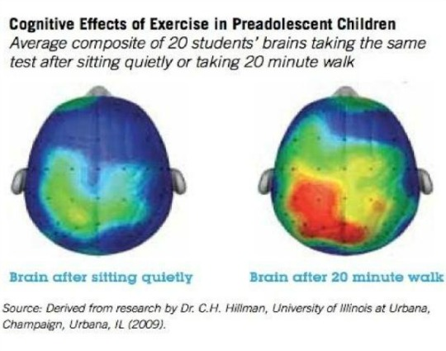
Why are Brain Breaks Important?
Boost blood flow
Send oxygen to the brain
Help kids better retain information

Slide 27
Why are Brain Breaks Important?
Kids need 60 minutes of daily physical activity every day.
Even incremental levels of physical activity can yield tremendous benefits in children’s lives.
Just 20 minutes a day of physical activity at school may be enough to prevent diabetes in children.
Especially beneficial for students with ADHD.

Slide 28
Hey, Teachers Need to Move Too!
Enough research already, let’s move!
Koo Koo Kangaroo, I Get Loose

Slide 29
How Do I Get Started?
Sign in for Free Account at gonoodle.com
Set up your class (4B 2017-2018)
Test out the brain breaks in the Demo
GoNoodle Plus, thank you BlueCross BlueShield!

Slide 30
When Should I Use It?
Morning meetings
After a difficult lesson
Before and after a big test
Subject transitions
To settle unruly students
Indoor recess
Afternoon slump
Get the wiggles out
Prep rally
Birthdays!
Koo Koo Kangaroo, Birthday Hooray!

Slide 31
Management
Explain the science behind brain breaks
Everyone must participate
Build trust and safety
Decide who will choose
Settling back to work

Slide 32
The Ins and Outs
Champs
Channels or Categories
GoNoodle Plus - Adding Content
YouTube
Certificates
GoNoodle at Home

Slide 33
Time to CHILLAX!
Koo Koo Kangaroo

Slide 34
Questions?

Slide 35
Contact Me!
brucekri@usd437.net @KristiBruce94 @KTOY2017 tinyurl.com/KTOY2017
aebruce.weebly.com

